Slide 1
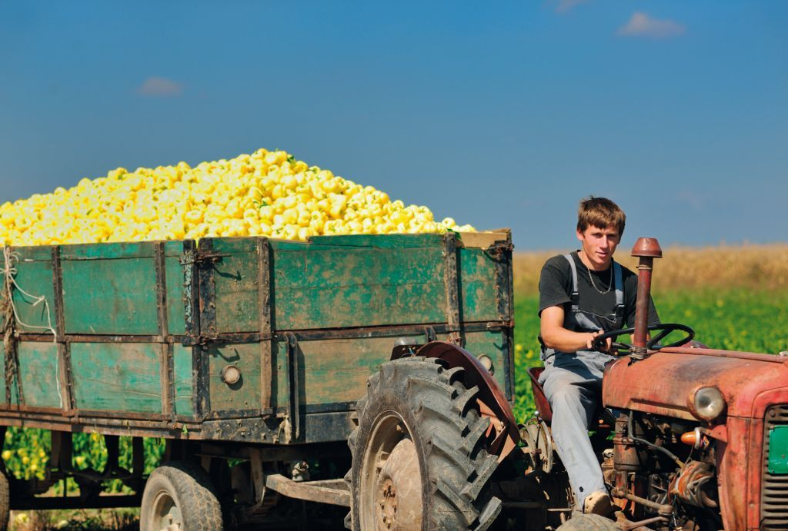
Semi-Subsistence Farming (SSF) in the EU
Value and directions of development
Ms Sophia DAVIDOVA, University of Kent
Mr Kenneth THOMSON, University of Aberdeen

Slide 2
Study Objectives and Approach
To assess the value of semi-subsistence farming in the EU, and the directions for its development
To evaluate the effectiveness of current and proposed CAP measures, and to draw up a set of policy recommendations
Case studies in: Bulgaria, Poland, Romania (NMS-12); Greece, Italy, Portugal (EU-15); interviews in: Hungary, Malta, Slovenia
Statistical analysis and existing studies

Slide 3
How large is the small and SSF sector in EU? (millions of farms, 2010)
 | Total | Up to 2ha | Up to 5ha | SO up to €2,000 | SO up to €8,000
EU-27 total | 12.1 | 5.6 | 8.1 | 5.1 | 8.5
NMS-12 total | 6.8 | 3.9 | 5.3 | 4.0 | 5.8
EU-27 SSFs | 5.8 | 4.0 | 5.2 | 3.9 | 5.5
NMS-12 SSFs | 5.0 | 3.4 | 4.4 | 3.4 | 4.7
Semi-subsistence farmers:
sell less than 50% of production, produce predominantly for own household consumption
are still pervasive in EU, despite structural change over time
are typically family-run, small-scale, often elderly

Slide 4
Roles of small and SSFs in rural Europe
Contribute to:
household budgets, food security at household level, mitigation of rural poverty
scenic landscapes and farmed biodiversity
local foods, short-supply chain
wider rural economy (off-farm jobs, services)
29/05/2013

Slide 5
Current EU Policy
CAP Pillar 1:
minimum payment rates often above “standard” €100 (e.g. Romania €200); most SSFs do not benefit
commodity market support not focused on sectors of major small and SSF importance
CAP Pillar 2:
few RDP schemes targeted to small and SSFs by MS RDPs (“large farm bias”)
Structural measures may help SSFs indirectly
Food chain measures not of much SSF benefit
29/05/2013
Semi-Subsistence Farming (SSF) in the EU
5

Slide 6
Share of farms benefitting from some RD measures (% of all farms in the size group)
RD measures | Bulgaria | Poland | Romania | Greece | Italy | Portugal
Farms larger than 5 ha
Agri-environment | 2.5 | 13.8 | 9.4 | 5.7 | 9.9 | 10.0
Modernisation | 5.6 | 4.1 | 0.3 | 1.0 | 3.1 | 1.1
Farms smaller than 5 ha
Agri-environment | 0.1 | 1.7 | 1.7 | 1.2 | 1.9 | 4.3
Modernisation | 0.02 | 0.1 | 0.01 | 0.2 | 0.4 | 0.2
Source: Authors’ computation based on Eurostat 2010
29/05/2013

Slide 7
Proposed EU Policy
Core CAP reform proposals will hardly affect SSFs
Small farmers scheme offers a substantial simplification
Reformed Pillar 2 requires appropriate design and delivery mechanisms for small and SSFs
Food sector proposals unlikely to match farms (location, type) most in need of adding value (e.g. in remote NMS areas) and market potential
29/05/2013
Semi-Subsistence Farming (SSF) in the EU
7

Slide 8
Conclusions
Current CAP does not “fit” small and SSFs
SSF development paths:
1/ disappearance; land absorbed or abandoned
2/ transformation to more commercialised farms
3/ continuation, e.g. part-time farming
Support to small and SSFs needs to be built around “public good” arguments, and their value beyond production of food, fibre, biomass
29/05/2013

Slide 9
Recommendations (1)
Pillar 1: Implement a small farmers scheme in line with EP proposals, i.e. voluntary amongst MSs but open to all holdings under certain thresholds
Pillar 2: either a/ to demonstrate how RDP takes care of the needs of small and SSFs or if not b/ to design a sub-programme
Additional technical assistance for design and implementation of the targeted sub-programme
29/05/2013

Slide 10
Recommendations (2)
ENRD - to build capacity among stakeholders representing small and SSFs by:
promoting a continuing theme on small farms within its portfolio of working groups and conferences
further research on RD needs and development options for small and SSFs as part of the above
FADN should be extended (in a modified and simplified form) to capture the wellbeing of small and SSFs and the impact of CAP measures
29/05/2013

